Slide 1
Status update

Slide 2
Things I got done
Found a really cool Finetuned bert model
Downloaded URSIM
Made a draft for the problemformulation

Slide 3
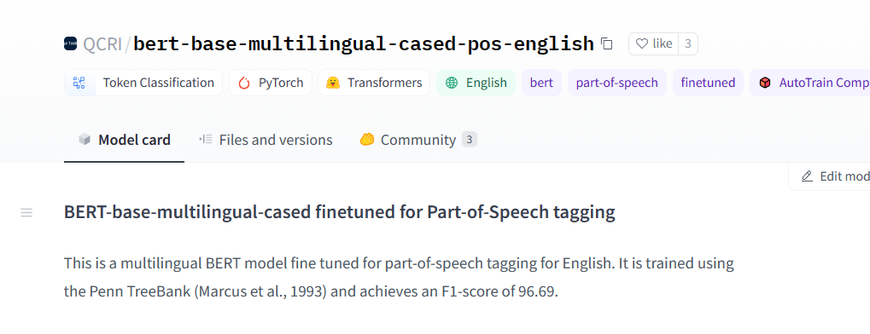

Slide 4
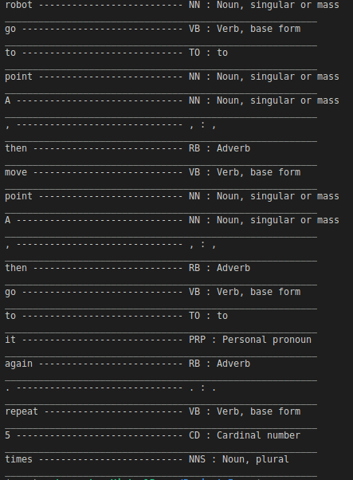

Slide 5
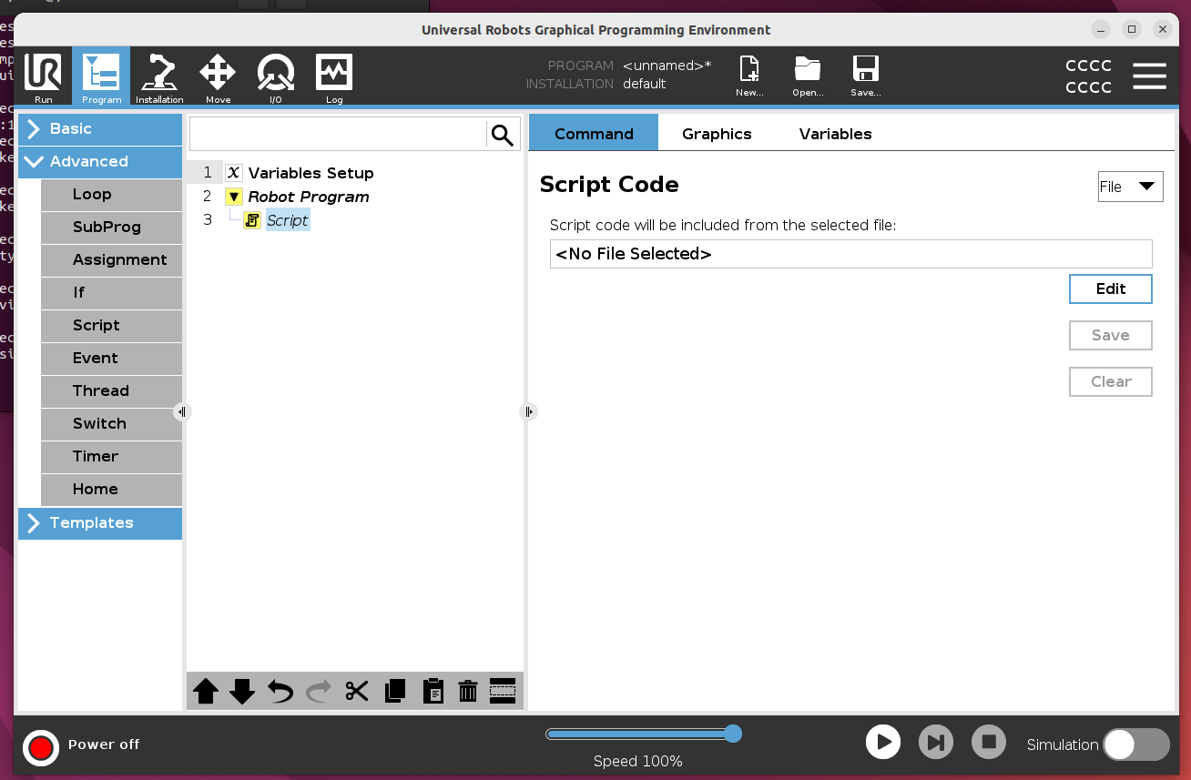
ursim

Slide 6
Problem formulation draft
In word

